Slide 1
Capturing Racial, Ethnic, and Gender Identity Data and Considerations for Analysis
Jody D Ciolino, PhD, Associate Professor, Northwestern University
Shokoufeh Khalatbari, MS, Manager, Biostatistics Program, Michigan Institute for Clinical & Health Research (MICHR), University of Michigan​
Sima Sharghi, PhD, Postdoctoral Research Fellow, University of Rochester Medical Center
Notes:
Jody

Slide 2
Notes:
Jody

Slide 3
Introduction to Speakers
Jody D Ciolino, PhD, Associate Professor, Northwestern University​
​
Shokoufeh Khalatbari, MS, Manager, Biostatistics Program, Michigan Institute for Clinical & Health Research (MICHR), University of Michigan
​
Sima Sharghi, PhD, Postdoctoral Research Fellow, University of Rochester Medical Center​
Notes:
Jody
Introduce self
Where in your career you are
Background in human subjects’ research
What drew us to this topic

Slide 4
Request for the audience
The speakers are a part of the Biostatistics, Epidemiology and Research Design (BERD) Justice, Equity, Diversity & Inclusion (JEDI) group
We and others within the BERD-JEDI group are drafting a manuscript inspired by the discussion points today
If there are points we may have missed or certain suggestions that you may have for the content of any pieces of dissemination related to this topic, please fill out a comment card and we can collect after the session
Notes:
Jody

Slide 5
Disclaimer:​
The views presented today are our own. They do not represent those of the statistical community nor those of our universities at large. ​
We have no relevant conflicts of interest.
Notes:
Jody

Slide 6
Goals for today – starting + continuing the dialogue
Present experiences and lessons learned in conducting research studies involving racial, ethnic, and gender identity data. ​
Illustrate options of setting up data dictionaries and demographic surveys for research study participants. ​
Review meaning of adjustment, confounding, heterogeneity of effects with respect to analytic variables representing these constructs. ​
We will touch on…Data capture → Data analysis → Reporting
Review updated guidance on the reporting of race and ethnicity in medical and science journals (JAMA)
Notes:
Jody
Objectives:
As a result of this presentation, the participant will be able to develop a set of survey questions for study participants to capture race, ethnicity, and gender data according to their specific study needs.
As a result of this presentation, the participant will be able to weigh the pros and cons of asking research study participants to provide data on racial, ethnic, and gender identity.
As a result of this presentation, the participant will be able to interpret analysis and research study findings when studies account for race, ethnicity, or gender.
Lay Summary: We will provide recommendations for capturing race, ethnicity, and gender-related data in research studies, calling upon several examples to illustrate pros and cons. We will also explain what it means to “adjust” for these variables in analysis. We ultimately hope to advocate for thoughtful consideration in capturing and handling these variables (if at all) in clinical research studies.

Slide 7
Some initial acknowledgments
Northwestern University Department of Preventive Medicine – Working Group in Response to Structural Racism in Research: https://www.preventivemedicine.northwestern.edu/research/research-equity-resources-page.html
DOIs: https://doi.org/10.18131/g3-j4wr-gf57 ; 10.18131/g3-5sa2-wb83
Previously recorded talk/session as part of “Statistically Speaking” lecture series:
https://feinberg-northwestern.hosted.panopto.com/Panopto/Pages/Viewer.aspx?id=4f5e9a0b-b972-46e6-967e-ae3101488e68&start=0
(a few others as well – iTHRIV as part of Virginia Tech, Colorado School of Public Health / Biostatistics & Informatics Seminar)
Notes:
Jody

Slide 8
Main idea
To keep in mind throughout…
Our general theme has to do with embedding a racial, ethnic, and gender equity perspective in research from inception to dissemination
Notes:
Jody

Slide 9
What is the goal/story you want to tell?
Embedding…from inception to dissemination
Restructuring, programming, etc.
Data Capture
Inference,
interpretation
Data Analysis
Reporting
(“telling the story”)
Notes:
Jody

Slide 10
Why is this important?
Remember the human subjects’ research space has downstream effects on clinical practice
ow anti-racist uprisings call us to act
From race-based to race-conscious medicine: how anti-racist uprisings call us to act. A Perspective in The Lancet, from Jessica P Cerdeña, Marie V Plaisime, and Jennifer Tsai. Lancet. 2020;396:1125-1128
Notes:
Jody
In case technical issues: https://www.youtube.com/watch?v=FlqQ4qvqcL8

Slide 11
Background
Notes:
Sima

Slide 12
Background:
No consistency in reporting the race/ethnicity
A study by Vyas DA et al [4] on reporting the race/ethnicity revealed that of 20,692 trials based in the U.S. between the years 2000 and 2020, including unpublished trials, only 43% of them reported the race/ethnicity of the participants.
What is the recommendation to deal with lack of diversity in research?
What is the role of the scientists to both encourage diversity and reporting on ethnicity/race?
Why is race/ethnicity considered a biological variable rather than a social construct?
Lack of diversity in Research participants: study results may not be generalizable and certain populations may not receive the same benefit from the research innovations. [8] (Akintilo, L. et al (2022))
Akintilo, L. et al (2022) about the lack of diversity in skin care/cosmetic benefits for people of darker skin.
Response to Structural Racism in Research?
Notes:
Sima
Why there is structural racism in research. (no consistency in reporting the race/ethnicity. Is the minimum enough? Is the lack of reporting the reason for this racisim? What is the recommendation to deal with lack of diversity in research. What do we do as scientists? Address the health disparities. Demographic consideration when capturing the data. )
Lack of participation by this group can render a therapy less trustworthy as a whole for the general public.
The reports are on the major participants and many minorities get excluded simply bc of the lack of participants.
Whys for collecting the race/ethnicity in methods. Why is race/ethnicity is considered a biological variable rather than a social concept.
Lack of knowledge about the real reason behind including race/ethnicity in the analysis
How to address the lack of participants? A research study [5] based on focused group investigations with participants from China, Korea and Vietnam showed that Cultural or religious beliefs are not believed to prevent clinical trial participation. Thus, this could have more to do with other factors including lack of access to this sub-group.
8. talks about the lack of diversity in skin care/cosmetic benefits for people of darker skin.
African American men make up 4% of prostate cancer (PC) clinical trials participation but are twice as likely to die from PC than white patients.
We would like to see and discuss the gaps to better deal with Structural Racism in Research.

Slide 13
Taking a step back + looking at
the big picture…
…..the research question
Notes:
Sima

Slide 14
Importance of the Research Question
The research question should shape the data capture and analysis.
Health and Healthcare Disparities or Structural Racism /Discrimination
Determining Structural Racism requires additional data
Racial Inequities in Access to Ventricular Assist Device and Transplant Persist After Consideration for Preferences for Care: (Thomas Cascino et al (2022))
Goes beyond just descriptive summaries to reveal a systematic bias that is hypothesized to exist within heart failure patients.
Notes:
Sima
Research question should help capture the right data. For example, different set of data is needed to show health disparity than the type of data needed to assess structural racism.
For example, health disparities among heart failure patient receiving advance life sustaining therapy has been well documented. For one of Shokoufeh's recent study, they aimed to answer the reason for this disparity. As a result they colledted lure patients receiving advance life sustaining therapy which was featured in CNN, the disparities have been well documented.
We want to see if the patients receive the same treatment based on their race/ethnicity. (Is there structural racism among patients.) They didn't get it bc they weren't offered (study the clinician bias) Going beyond to know what kind of information you need to understand the clinician bias in offering the treatment.
Asked the patients and their preferences. You should collect the data in a way that it reveals if there is actually the bias.
Look back at the second paper.
Research study by Ginther DK et al. in which they analyze the relationship between gender, race/ethnicity, and the probability of being awarded an R01 grant from the National Institutes of Health (NIH).
They intentionally seek to reveal any possible underlying disparities that may or may not exist among those seeking R01 award.

Slide 15
Importance of the Research Question
The research question should shape the data capture and analysis.
With respect to racial, ethnicity and gender equity……
Health
&
Healthcare Disparities
Structural Racism or
Discrimination
OR
Determining Structural Racism goes beyond establishing health disparities and usually requires collecting additional data​
Notes:
Sima
The data capture and analysis approach are different when you want to determine if health disparities and inequity exists than when you aim to show evidence of structural racism. For later you have to gather additional data and perform such analysis to be able to go beyond just showing disparities.

Slide 16
Importance of the Research Question Example study
Racial Inequities in Access to Ventricular Assist Device and Transplant Persist After
Consideration for Preferences for Care: (Thomas Cascino et al (2022), featured in CNNhealth)
The study went beyond recognizing disparities and aimed to investigate structural racism
Data collected:
Race: Black (n=100) vs white (n=277)
Demographics
Social Determinants of health
Clinician-assessed HF severity
Patient-reported quality of life
Patient preference and desire for receiving advanced therapies
Conclusion:
"Among patients receiving care by advanced HF cardiologists at VAD centers, there is less utilization of VAD and transplant for Black patients even after adjusting for HF severity, quality of life, and social determinants of health, despite similar care preferences. This residual inequity may be a consequence of structural racism and discrimination or provider bias impacting decision-making."
Notes:
Sima
Health disparities among heart failure (HF) patient receiving advanced life-sustaining therapies are well documented so the study aimed to examine the source of the disparities.
Look back at the second paper.
Research study by Ginther DK et al. in which they analyze the relationship between gender, race/ethnicity, and the probability of being awarded an R01 grant from the National Institutes of Health (NIH).
They intentionally seek to reveal any possible underlying disparities that may or may not exist among those seeking R01 award.

Slide 17
When to Adjust
Should we always adjust?
A research by Shapiro, J., et al. (2021) [7] says when studying how age (predictor) impacts the likelihood of getting COVID-19 vaccine (outcome), adjusting for sex and gender assumes that the change in the likelihood of getting vaccinated with age is the same for men and women. However, this assumption might not be true (more on this idea of confounding later).
Notes:
Sima
The idea will be unpacked as we go through the talk in analysis section
For instance, if the study is about capturing the association of a predictor and an outcome, including sex as a confounder might complicate this relationship.

Slide 18
Now, when we think about implementing the study we’ve designed and embedding a racial and ethnic and gender equity perspective in research, from inception to dissemination…​
Notes:
Sima

Slide 19
Points to consider in advance of the study initiation
Audience – who is going to hear the story?
Audience may include…
People of the community
Other researchers
Clinicians
Funders
Etc.
What is the ultimate message you will want to convey with respect to these data types?
Describing the sample
“Adjusting” or “controlling” for (potential) confounding effects
Heterogeneity in effects
Notes:
Sima
What is the ultimate message. Say the points as if they are questions.

Slide 20
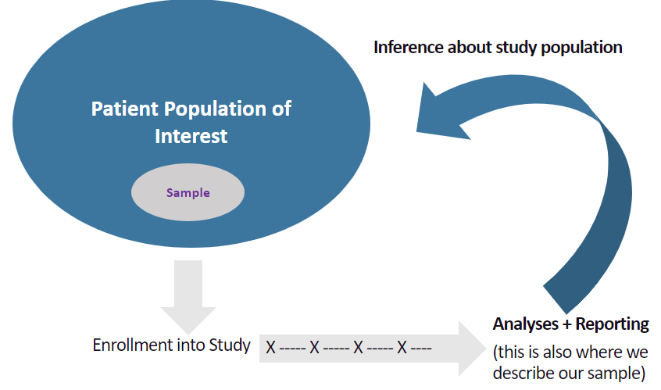
Describing the Sample – What do we mean and why do we do it?
Notes:
Sima:
We want to have a sample that is represented of the population.
Enroll the sample in the study.
Reporting of the analyzing

Slide 21
Describing the Sample For a research, reviewer, clinical, lay audience
“Table 1” – typically includes a description of demographic characteristics of your study participants
Age
Sex
Gender identity
Race
Ethnicity
Etc.
For example…
Notes:
Sima

Slide 22
Kim HS, Ciolino JD, Lancki N, Strickland KJ, Pinto D, Stankiewicz C, Courtney DM, Lambert BL, McCarthy DM. A Prospective Observational Study of Emergency Department–Initiated Physical Therapy for Acute Low Back Pain. Physical therapy. 2021 Mar;101(3):pzaa219.
This table gives us some idea of the study population
There are things that could have been done better (or worse)
It’s a start…
Notes:
Sima
When we consider the ultimate goal of capturing these data as describing the participant cohort or understanding generalizability of the study findings (or lack thereof), we often think of the typical “Table 1” of a research article. The general reasoning for this Table 1 is to help us determine both generalizability and gaps. However, when we look at some typical practices in displaying these data in Table 1, we note some problems. For example, the “other” racial category is often too broad to really understand the participant identity within that group. Another common issue is the “Asian” category that is rather broad.

Slide 23
Describing the Sample For a research, reviewer, clinical, lay audience
“Table 1” – typically includes a description of demographic characteristics of your study participants
Age
Sex
Gender identity
Race
Ethnicity
Etc.
The reason for “Table 1” in Human Subjects’ Research
Describing the “sample” from the population
Allowing the audience to understand the generalizability (or lack thereof) of findings
Identifying reach and gaps of research
Notes:
Sima

Slide 24
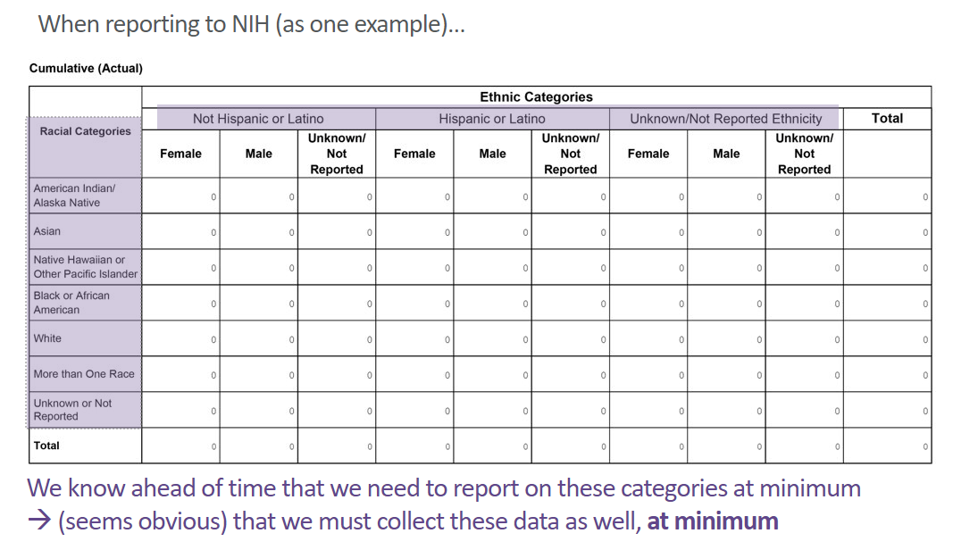
Describing the Sample - funder or regulatory
Notes:
Sima
This should look familiar to a lot of people in the audience – this is what our funder expects us to use to “describe” our sample
So at minimum, regardless of other plans for reporting, we need to capture these data

Slide 25
A note on the ‘Asian’ Category:
Notes:
Sima:
Slight digression on this broad “Asian” category – something to consider here
It is best to collect the data at granular data. Later for analysis even if they are lumped together at least the audience would know more about the participants background. This is important specially bc the lived experience of a person of Chinese decent could be different from someone from Sri Lanka.

Slide 26
Data Capture
Notes:
Shokoufeh

Slide 27
Going back to capturing the data ​Assume for a moment the sole purpose = to describe the sample
Knowing the purpose allows us a starting point for data capture
If NIH-funded study, we can start here
Race:
American Indian / Alaska Native
Asian
Native Hawaiian / Pacific Islander,
Black or African American
White
More than one Race
Ethnicity:
Hispanic or Latino
Not Hispanic or Latino
Restructuring, programming, etc.
Data Capture
Data Analysis
Inference,
interpretation
Reporting
(“telling the story”)
Notes:
Shokoufeh to take this section
Update + feel free to add some components of the guidance referenced

Slide 28
If we start there, this may be what a data collection tool looks like (for a participant) – Example Case Report Form (CRF)
While this may serve the needs of the study for purposes of reporting and describing the sample…
Notes:
Shokoufeh

Slide 29
From the participant perspective… This setup may be confusing
Possible participant perspective
Recommendation
“Why do you need this information?”
Explain the purpose – in the consent or in instructions for survey.
“Collecting information on race and ethnicity helps us understand our study participants’ background. It will help people reading the study results understand whether the study may or may not apply to them or their patients.”
Allow participants
to select “choose not to answer” for these questions (preferred) or
to skip the question(s) altogether.
“I would prefer not to give you this information.”
Notes:
Shokoufeh

Slide 30
From the participant perspective… This setup may be confusing
Possible participant perspective
Recommendation
Allow participants to “select all that apply.”​
​
​
Allow for an “unsure” option.​
​​
Allow an “other” option or “some other race or ethnicity”.​
– Consider: If “other”, specify. ​
Note – this may provide inconsistencies with data entry and open up opportunity for error, but may be worth the effort here.
“I identify with many of these options; it seems silly to make me choose just one.”​
​
“I don’t know how to answer this. I am not sure what this means.”​
​
“None of these options really apply to me.”
Notes:
Shokoufeh

Slide 31
From the participant perspective… This setup may be confusing
Possible participant perspective
Recommendation
“What is the difference between race and ethnicity? They seem to be asking the same thing from my perspective.”
“These categories feel very general. How can you group people of Indian, Chinese, Japanese, Korean, Thai, Indonesian [and many other] descent into just one broad category?”
– Consider whether is it necessary to break the two constructs apart – you could consider capturing together in one field/set of fields. ​
– Ask a question that does not specifically state “ethnicity” in the label…”Do you consider yourself Hispanic?”​
​
– Consider capturing data on a more granular level
– you can always collapse into larger, “required” categories after the fact. This is preferred over risking participant difficulty with answering these questions.
Notes:
Shokoufeh

Slide 32
Other options for data collection… Example CRFs / Data Collection Tools
Notes:
Shokoufeh

Slide 33
Other options for data collection… Example CRFs / Data Collection Tools
Notes:
Shokoufeh

Slide 34
Other options for data collection… Example CRFs / Data Collection Tools
Notes:
Shokoufeh

Slide 35
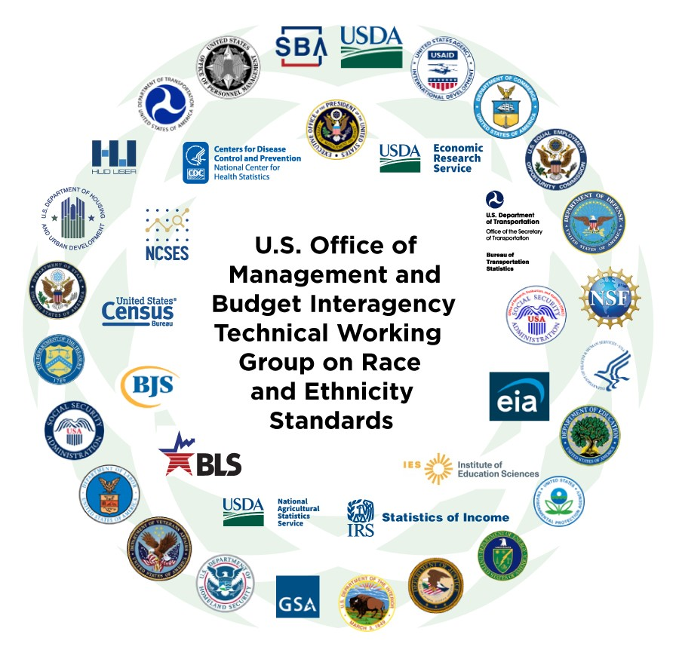
The White House: The office of Chief Statistician
Initial Proposal for Revising the Federal Race and Ethnicity Standards:
Collecting race and ethnicity together with a single question;
Adding a response category for Middle Eastern and North African, separate and distinct from the “White” category; and
Updating Statistical Policy Directive (SPD) No 15’s terminology, definitions, and question wording
Comments may be provided by 04/27/2023: spd15revision.gov
https://www.whitehouse.gov/omb/briefing-room/2023/01/26/initial-proposals-for-revising-the-federal-race-and-ethnicity-standards/
Notes:
The White House Chief Statistician, Dr. Karin Orvis has made the following initial proposal. SPD 15 provides a minimum set of categories that Federal agencies must use if they intend to collect information on race and ethnicity. As of Monday they have received over 18,000 comments. Dr. Felicity Enders, the Chair of ACTS Justice equity, diversity and inclusion special interest group has provided our feedback and support for these revisions.

Slide 36
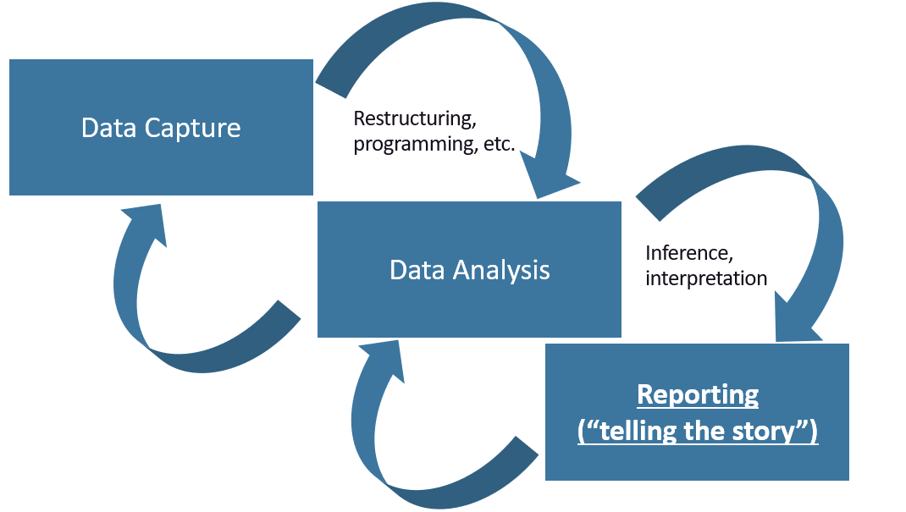
Now let’s go back to capturing the data and focusing on sex and gender identity Assume for a moment the sole purpose = to describe our sample
If NIH-funded study, we can start here with the “sex as a biological variable” requirement
This often means:
Minimum requirement is biological sex as assigned at birth (most often: male or female)
Gender identity variable (the gender with which a person identifies (if any) may not be required, depending on the study purposes
Notes:
Shokoufeh

Slide 37
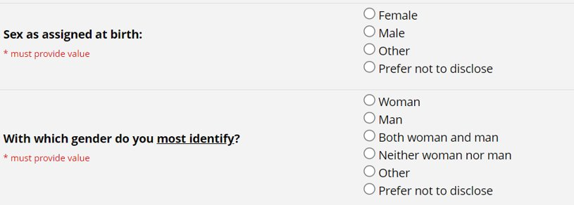
Some example segments of data collection tools around sex / gender… It is imperative to know the distinction between the biological variable of sex vs the identity variable gender (these may not always match one another – notion of ‘cis’ or ‘trans’ comes into play here)
Study #1: only interested in sex as defined at birth for study purposes
Study #2: interested in sex as assigned at birth AND gender identity are of interest here
Notes:
Shokoufeh

Slide 38
Summary on Data Collection
Consider the audience and target study population. Depending upon country, culture, or age group of interest, these data may not apply or the study participants may not understand the social construct or categories of race or ethnicity (as one example). ​
Explain the purpose of this data collection to study participants (either within the consent or in the instructions of the relevant survey). Why do you want this information?​
Consider the goal of collecting these data (reporting only vs. analyses?). Do you need this information? ​
If the study is short-term (e.g., less than one year in length), these data will likely only require collection at “baseline.” If the study is longer-term, investigators should recognize that racial/ethnic/gender identity from a participant’s perspective may change over time. Therefore, the investigators could consider allowing participants to provide updates on these variables as their time in the study progresses. ​
Notes:
End Shokoufeh Section

Slide 39
Analysis

Slide 40
On Analysis Regarding Racial, Ethnic, and Gender Data Points to consider in advance of the study initiation
Audience – who is going to hear the story?
Audience may include…
People of the community
Other researchers
Clinicians
Funders
Etc., etc.
What is the ultimate message you will want to convey with respect to racial/ethnic/gender data?
Describing the sample
“Adjusting” or “controlling” for (potential) confounding effects
Heterogeneity in effects
Health disparities by race and ethnicity (or gender)
Notes:
Jody

Slide 41
Using Race/Ethnicity/Sex/Gender Variables in Analysis What is the meaning?
Consider an example (using race/ethnicity)…​
Study participants are enrolled into a randomized interventional study (a clinical trial).​
- Arm 1 = cognitive behavioral therapy (CBT)​
- Arm 2 = treatment with antidepressant ​
Participants are followed for 2 years, and have study visits every 6 months.​
Primary outcome of interest is depressive symptom severity score. ​
Primary aim: to evaluate intervention effects on depressive symptom scores over time.
Notes:
Jody

Slide 42
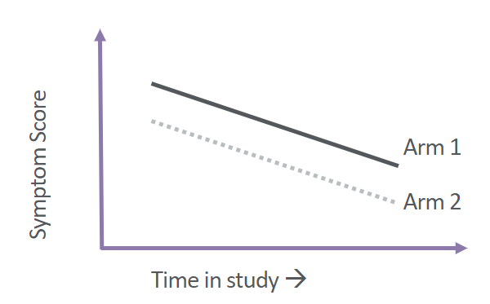
Race / Ethnicity Variables in Analysis Hypothetical Example
Analysis plan:
H0: mean depression score for patients treated with CBT = mean depression score for patients treated with antidepressants.
H1: mean scores in the two patient groups are not equal.
Longitudinal modelling techniques to compare depressive symptom scores over time
One example analytic strategy: Y = intercept + time + study arm + error + error
Visually, this model assumes…
Notes:
Jody

Slide 43
What typically comes next? After primary analyses
Sometimes controlling for multiple potential covariates of interest (if that wasn’t already a part of the plan)​
- Example – “controlling for race”, “controlling for ethnicity” ​
- How often do we hear: “Did you control for race?” from reviewers?​
Recommendation – if this is not of interest, not part of the study goals, really consider whether it makes sense to perform additional analyses controlling for race.​
- Sometimes it makes sense to add in some sort of sensitivity analysis​
- Sometimes it does not – it is okay to push back here
Notes:
Jody

Slide 44
What typically comes next? After primary analyses
If we have reason to believe that race or ethnicity does have an effect on outcome (in this case depression scores), and it is scientifically justified, consider adjusting for race or ethnicity.​
Ideally, this would be a pre-specified adjustment. ​
Example: perhaps there is reason to believe that those self-identifying as Hispanic have differing depressive symptoms scores, in general, than those not self-identifying as Hispanic. ​
To control for this (assumed) difference, your new model becomes something like: ​
Y = intercept + time + ethnicity + study arm + error + error
Notes:
Jody

Slide 45
What does this mean? Y = intercept + time + ethnicity + study arm + error + error
Assumption: there is an inherent difference in symptom scores between these two groups, regardless of treatment. → Is this a valid / justified assumption? ​
It is impossible, in a randomized study to obtain perfectly “balanced” distributions of all variables across study arms. ​
Adding in variables for which there is an assumption like this helps increase precision on the estimate of interest (i.e., that study arm effect).
Notes:
Jody

Slide 46
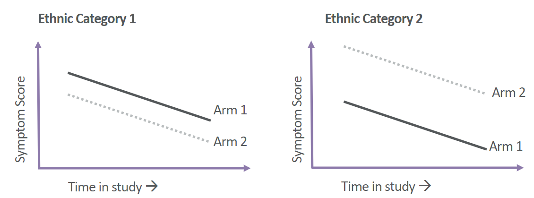
What about heterogeneity in treatment effects? Usually more exploratory in nature, unless these are primary goals of the research study
What does this mean in context of our example?
Do we have evidence of a differing study arm effect within groups of participants self-identifying as specific ethnic categories?
This may be one hypothesized view of this heterogeneity – there are countless.​
Statistically… ​
Y = intercept + time + (ethnicity)*study arm + error + error​
Notes:
Jody

Slide 47
In analyses, things get complicated very quickly Some general recommendations
Go back to your research strategy and the overall study goals, hypotheses, design, etc.
Pay attention to your study population​
Are adjustments or evaluations for heterogeneity even possible? ​
Did you collect the data in such a way to allow for this? ​
Even if these analyses are a part of the study goals, they may not be possible as group / cell counts may be too low…
Notes:
Jody

Slide 48
An example on considerations for analyses Suppose…
We have a study similar to the one on depressive symptoms previously described.​
We would like to control for race in analyses.​
We pre-specify this plan to adjust for self-identified race in analysis. ​
However, here is our distribution of our participants’ self-identified racial categories:
Self-Identified Race​ | N​ | %​
Asian​ | 4​ | 4%​
Black ​ | 1​ | 1%​
Multiple Races​ | 5​ | 6%​
White​ | 78​ | 89%​
Total​ | 88​ | 100%​
Notes:
Jody

Slide 49
Example, continued​
Statistically, the largest subgroup provides the most “information” in the model. Larger subgroups tend to result in increased precision and more stable model estimates.
Self-Identified Race​ | N​ | %​
Asian​ | 4​ | 4%​
Black ​ | 1​ | 1%​
Multiple Races​ | 5​ | 6%​
White​ | 78​ | 89%​
Total​ | 88​ | 100%​
If we leave these categories as is and put
“race” as a four-category factor into our statistical model…​
We will most likely end up with nonsensical parameter estimates and confidence intervals (model instability issues) due to really low cell counts. ​
We may end up with a lack of anonymity
issue in reporting here as well.​
Notes:
Jody

Slide 50
So what should we do?
Can we collapse these categories?
Self-Identified Race​ | N​ | %​
Asian​ | 4​ | 4%​
Black ​ | 1​ | 1%​
Multiple Races​ | 5​ | 6%​
White​ | 78​ | 89%​
Total​ | 88​ | 100%​
Self-Identified Race​ | N​ | %​
Asian / Black / Multiple Races ​ | 10​ | 11%​
White​ | 78​ | 89%​
Total​ | 88​ | 100%​
Does it still make sense to “adjust” for race in analyses? ​
The team decided “no” and determined it more appropriate to report/summarize only.​
Reason: it did not make sense/there was no scientific justification for assuming
that depressive symptoms would be inherently different across such a broad subgroup.
Notes:
Jody

Slide 51
Other Considerations & Reporting

Slide 52
Other considerations
Algorithmic bias in Medicine
Biased clinical algorithms lack data diversity: by race, sex, or other factors
An example of biased clinical algorithm is the race-based adjusted eGFR algorithm
Algorithmic bias in medicine can have devastating effects on people of
color at all points in the health care process, from triaging their illnesses to
the quality of care they receive
Race-adjusted tools should be avoided as they use race as a biological construct
rather than a social construct
“Medical Algorithms Are Failing Communities Of Color”, Health Affairs Blog, September 9, 2021.DOI: 10.1377/hblog20210903.976632​
Vyas DA, Eisenstein LG, Jones DS. Hidden in plain sight—reconsidering the use of race correction in clinical algorithms. N Engl J Med. 2020;383:874-882 ​
Notes:
Shokoufeh

Slide 53
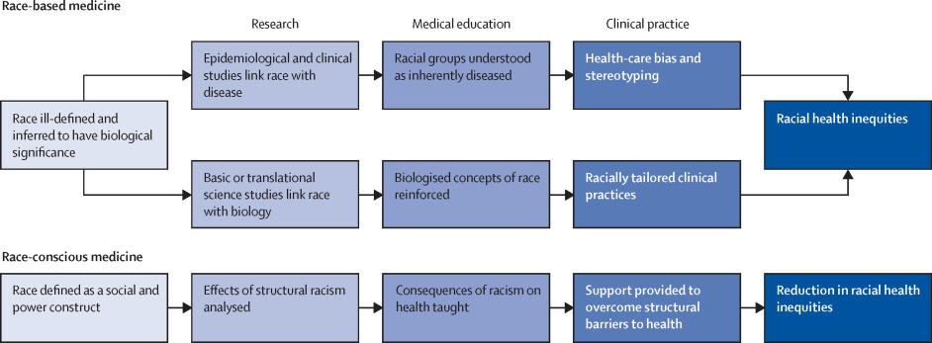
Algorithmic Bias in Medicine
How race-based medicine leads to racial health inequities…….
Cerdeña JP, Plaisime MV, Tsai J. From race-based to race-conscious medicine: how anti-racist uprisings call us to act. Lancet. 2020;396:1125-1128
Notes:
Shokoufeh

Slide 54
Examples of Race ‘Correction’ in Clinical Medicine:
Tools | Clinical Utility | Use of Race | Equity Concern
Cardiology: Heart Failure Risk score | Predicts in-hospital mortality in patients with acute HF | Add 3 points to the risk score for non-blacks, indicating higher risk | designates blacks as lower risk
Cardiac Surgery: Short term risk Calculator | Predicts risk of complication and mortality with common cardiac surgeries | Increases risk scores for black patients | Using preoperatively, Black patients are steered away form these procedures
Nephrology: eGFR* | A measure of kidney function | Assigns higher eGFR to blacks Indicating better function for blacks | Indicating better function for blacks, may delay referral to specialist
Obstetrics: VBAC* Risk Calculator | Predicts successful vaginal birth after prior cesarean section | Blacks or Hispanics have lower success rate | May discourage clinicians to offer vaginal birth to people of color
Urology: STONE Score UTI calculator | Predicts risk of stone in ureteral Estimates the risk of UTI in children 2 - 23 months old. | Higher score indicates higher risk. 3 points are added to non-black race Assigns lower likelihood of UTI for black children | By systematically reporting lower risk for black patients, clinicians may not aggressively evaluate black patients. By systematically reporting lower risk for black children, clinicians may not pursue definitive diagnostic testing of black children with UTI symptoms
Oncology: Rectal Cancer Survival calculator | Estimates conditional survival 1 – 5 yr after diagnosis | Blacks have higher coefficient indicating shorter cancer specific survival rate | Clinicians may be reluctant to offer interventions for patients with lower survival rate
Cerdeña JP, Plaisime MV, Tsai J. From race-based to race-conscious medicine: how anti-racist uprisings call us to act. Lancet. 2020;396:1125-1128
Notes:
Shokoufeh

Slide 55
What can clinicians do?
Be aware and be transparent with patients about the use of race in clinical algorithms and their algorithmic risk.
Start having the conversation at the institution level.
Those who are convinced that race should be taken out of algorithms can also alter practice on their own.
Calculate patients’ risk with and without race in the algorithm and examine if that would change patients perceived risk profile with respect to a relevant threshold.
Cerdeña JP, Plaisime MV, Tsai J. From race-based to race-conscious medicine: how anti-racist uprisings call us to act. Lancet. 2020;396:1125-1128
Vyas DA, Eisenstein LG, Jones DS. Hidden in plain sight—reconsidering the use of race correction in clinical algorithms.
N Engl J Med. 2020;383:874-882
Notes:
Shokoufeh

Slide 56
Reporting race and ethnicity in medical and science journals: Updated Guidance (JAMA 2021)
Goal: “To provide recommendations and suggestions that encourage fairness, equity, consistency, and clarity in use and reporting of race and ethnicity in medical and science journals.”
Significance: “Terminology, usage, and word choice are critically important, especially when describing people and when discussing race and ethnicity. Inclusive language supports diversity and conveys respect. Language that imparts bias toward or against persons or groups based on characteristics or demographics must be avoided.” Flanagin A, Frey T, Christiansen SL, AMA Manual of Style Committee. Updated guidance on the reporting of race and ethnicity in medical and science journals. JAMA. 2021;326(7):621-627. doi:10.1001/jama.2021.https://jamanetwork.com/journals/jama/fullarticle/2783090
Notes:
Shokoufeh
Updated guidance to promote inclusive language in medical publications

Slide 57
Updated Guidance - key points:
Race and ethnicity are social constructs
Reporting of race and ethnicity should not be considered in isolation and should be accompanied by other sociodemographic factors and social determinants and the intersectionality of race and ethnicity with these other factors.
Inclusion of race and ethnicity in reports of medical research remain important for addressing concerns about racism, health disparities and inequalities
Language and terminology must be accurate, clear, and precise, and must reflect fairness, equity, and consistency in use and reporting of race and ethnicity
Report should include who identified participant race and ethnicity and the source of the classifications used (e.g., self-report or selection, investigator observed, database, electronic health record, survey instrument)
Notes:
Shokoufeh
first an acknowledgment that race and ethnicity are social constructs not a biological category defined by genetic traits so as social constructs they should not be used as biological differences but they may be used as way to which to study and assess racism and health disparities.
Second: race and ethnicity should not be considered in isolation so other socio demographic factors and context should be included as much as possible these variables are essential for assessing health disparities
Third: I n addition to including who classified the participants, it should be clearly described who classified individuals, what categories were available to them and how the selections were made
White privately insured vs white or black Medicaid-insured geeting within a category of race/ethnicity

Slide 58
Updated Guidance: Instructions for Authors on Collection and Reporting of race and ethnicity:
The Methods section should include an explanation of who identified participant race and ethnicity and the source of the classifications used (eg, self-report or selection, investigator observed, database, electronic health record, survey instrument).
If race and ethnicity categories were collected for a study, the reasons that these were assessed also should be explained in the Methods section. If collection of data on race and ethnicity was required by the funding agency, that should be noted.
Notes:
Shokoufeh

Slide 59
Updated Guidance continued….
Specific racial and ethnic categories are preferred over collective terms, when possible. Authors should report the specific categories used in their studies and recognize that these categories will differ based on the databases or surveys used, the requirements of funders, and the geographic location of data collection or study participants. Categories included in groups labeled as “other” should be defined.
Avoid collective reference to racial and ethnic minority groups as “non-white.” If comparing racial and ethnic groups, indicate the specific groups.
Notes:
Shokoufeh

Slide 60
Updated Guidance continued….
Categories should be listed in alphabetical order in text and tables.
Race and ethnicity categories of the study population should be reported in the Results section
For more information refer to:
“Updated Guidance on Reporting Race and Ethnicity in Medical and Science Journals.”
Notes:
Shokoufeh

Slide 61
Tying it all together
We have presented some considerations to help serve as guidelines and recommendations for Human Subjects’ Research. ​
The hope is that the individual investigative team can take this information and lessons learned here + apply it to their own research study(ies) needs with special attention to their study participant needs. ​
​
Please keep in mind that research studies will all have unique needs, and there is no single set of best practices that would apply to all studies. ​
​
“There is no such thing as a perfect study.” Friedman, Furberg, DeMets; Fundamentals of Clinical Trials.
Notes:
Shokoufeh

Slide 62
“Not everything that is faced can be changed, but nothing can be changed until it is faced.”
― James Baldwin
Notes:
Shokoufeh

Slide 63
References
Medical Algorithms Are Failing Communities Of Color”, Health Affairs Blog, September 9, 2021.DOI: 10.1377/hblog20210903.976632
Flanagin A, Frey T, Christiansen SL, AMA Manual of Style Committee. Updated guidance on the reporting of race and ethnicity in medical and science journals. JAMA. 2021;326(7):621-627. doi:10.1001/jama.2021.
Cerdeña JP, Plaisime MV, Tsai J. From race-based to race-conscious medicine: how anti-racist uprisings call us to act. Lancet. 2020;396:1125-1128
Vyas DA, Eisenstein LG, Jones DS. Hidden in plain sight—reconsidering the use of race correction in clinical algorithms. N Engl J Med. 2020;383:874-882
Brandon E. Turner, Jecca R. Steinberg, Brannon T. Weeks, Fatima Rodriguez, Mark R. Cullen, Race/ethnicity reporting and representation in US clinical trials: A cohort study, The Lancet Regional Health - Americas,Volume 11, 2022, 100252, ISSN 2667-193X.
Ma GX, Seals B, Tan Y, Wang SY, Lee R, Fang CY. Increasing Asian American participation in clinical trials by addressing community concerns. Clin Trials. 2014 Jun;11(3):328-335.
Shapiro, J., Klein, S., & Morgan, R. (2021). Stop 'controlling' for sex and gender in global health research. BMJ Global Health, 6(4).
Akintilo, L., Pulavarty, A., Onwudiwe, O., Garibyan, L., & Lee, K. (2022). Skin of color representation in cosmetic clinical trials: A literature review. Lasers in Surgery and Medicine, 54(6), 819–822. doi:10.1002/lsm.23546

